Slide 1
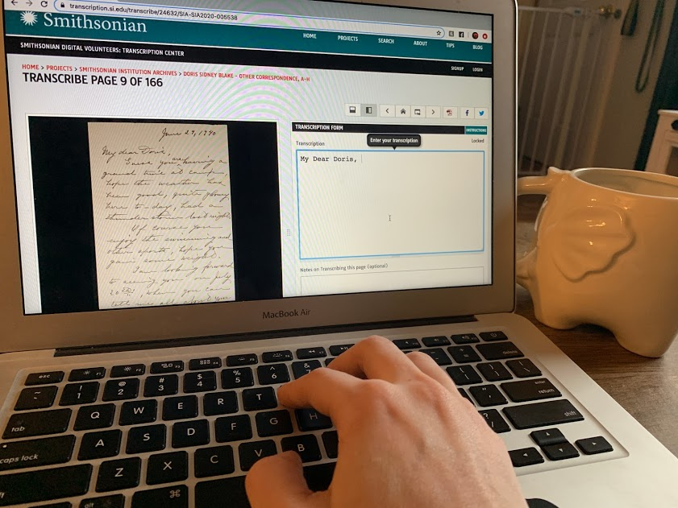
Smithsonian Transcription Center Transcribe-a-thon
[[organization hosting]]
[[date]]

Slide 2
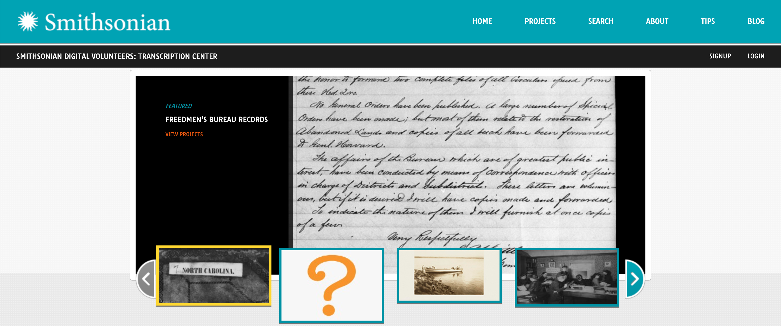
Smithsonian Transcription Center
transcription.si.edu

Slide 3
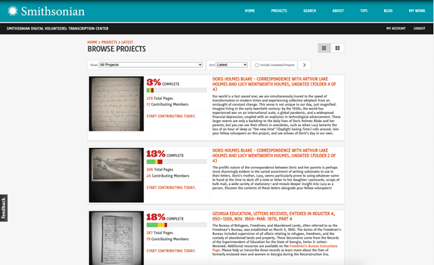
Background
Founded in 2013, the Smithsonian Transcription Center is a website inviting the public to collaboratively transcribe, review, and explore, digitized Smithsonian collections. This work makes our historic materials more readable, accessible, and text-searchable across our online databases and other major search engines.

Slide 4
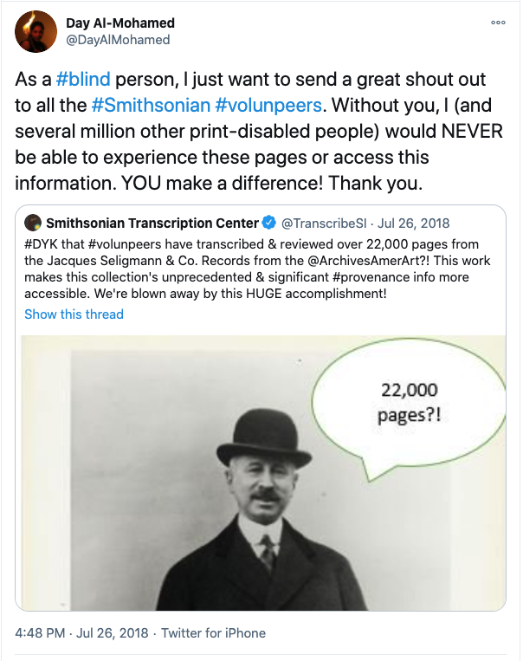
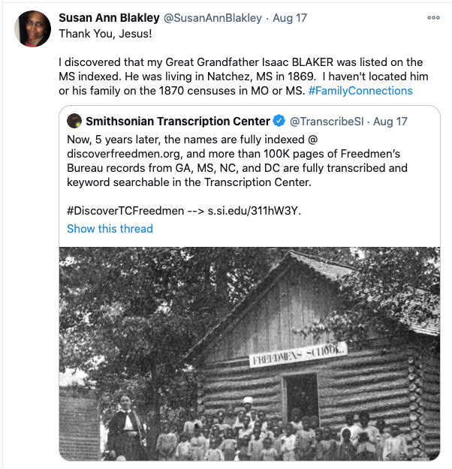
Impact
Transcription enables:
New discoveries
Enhanced access to historic collections
Keyword-level searchability
Connections across collections inside (and outside!) the Smithsonian

Slide 5
Introductory Video

Slide 6
Getting Started
Step 1: Register for an account
transcription.si.edu/user/login
Step 2: Review Instructions
transcription.si.edu/tips
Step 3: Explore Projects
transcription.si.edu/projects

Slide 7
Step 4: Transcribe or Review
Review
Transcribe
Choose an ongoing project
To start -> click the blue “Transcribe” button or scroll down to find pages (gray or red) labeled “Start/Continue Transcribing”
Type in the transcription box exactly what you see written in the original document
Helpful Resources:
General Instructions
Introductory Video
Chose an ongoing project
To start -> click the orange “Review” button or scroll down to find pages (yellow) labeled “Needs Review”
Carefully compare the typed transcription with the original document, checking for any missed words or errors – if found, click “reopen for editing”
Helpful Resources:
Review instructions
Review Tips

Slide 8
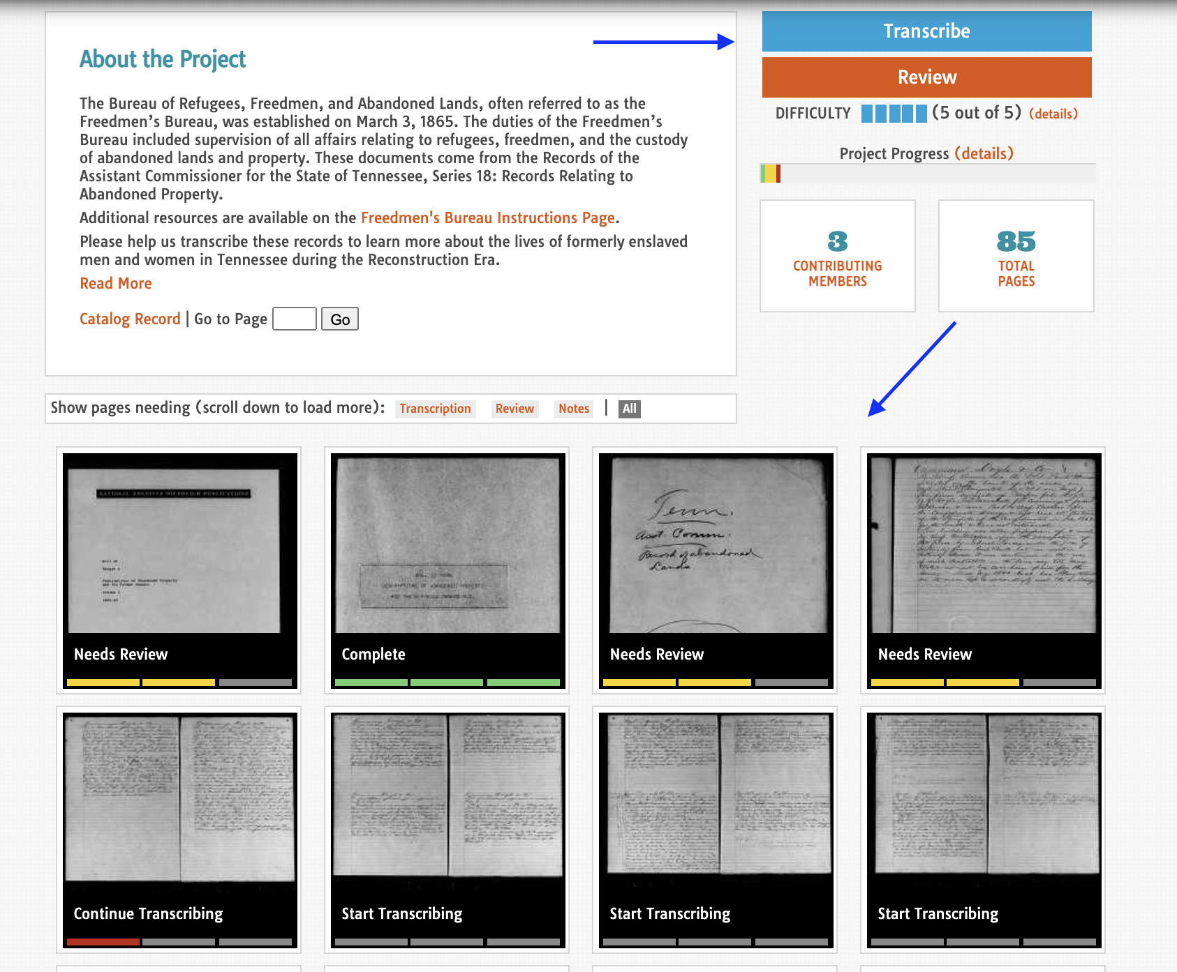

Slide 9
When in Doubt:
Review the overall TIPS page (including a helpful instructional video) -> https://transcription.si.edu/tips
Search for individual names, places, etc. within the TC “search” page or via Google OR click on the catalog record link in the project to learn more about the collection.
Review other completed pages in the project you’re working on to see how others have done it.
Stuck on a word? Type [[?]] and ”save”
Reach out! Via the “Feedback button” or email at transcribe@si.edu

Slide 10
Transcribe@si.edu Share your experience! @TranscribeSI @smithsoniantranscriptioncenter #WhyITranscribe #MyTCDiscovery #Volunpeers

